Slide 1
IBM University Engagement Project Submission
“Exploring the Power of Agentic AI with IBM watsonx Orchestrate”

Slide 2
Project Tile – AdmissionGPT
Domain of Project – Education
Student Name | Recent Passport Photo | Email ID | Mobile number [WhatsApp]
Farhana Siddiqui |  | farhana.siddiqui1977@gmail.com | 8850191881

Slide 3
Problem Statement: AdmissionGPT
Choosing the right college and course is a challenging process for students and parents due to scattered information about colleges, admission criteria, cutoffs, fees, rankings, placements, and eligibility requirements. Students often find it difficult to compare colleges, analyze previous year admission trends, and make decisions according to their academic performance, interests, budget, and career goals.
The objective is to build an AI-powered Admission Agent that provides personalized college recommendations and admission guidance. The system retrieves reliable admission data such as rankings, accreditation, eligibility criteria, opening and closing ranks, category-wise cutoffs, state quota details, fees, hostel information, and placement records. It helps students shortlist suitable colleges, compare options, estimate admission chances, and receive guidance throughout the admission process.
The solution uses a multi-agent approach including an Admission Knowledge Agent for collecting college data, a College Recommendation Agent for suggesting suitable colleges and branches, an Admission Advisory Agent for counseling and application support, and a College Comparison Agent for decision-making. A visualization dashboard displays college comparisons, cutoff trends, admission probability, deadlines, and student progress to make the admission journey easier and more informed.

Slide 4
Technology Used
Tech Stack (Mandatory)
Use any one of the following approaches:
LangFlow + IBM watsonx.ai + Granite Models
IBM Cloud Agentic Lab with IBM Granite Models
Replicate with LangChain + RAG + IBM Granite Models
I used IBM watsonx.ai + Granite Models

Slide 5
Proposed Solution -
Proposed Solution: AdmissionGPT
The proposed solution is an AI-powered Engineering College Comparison Agent that helps students compare Mumbai engineering colleges and make informed admission decisions. The system uses a RAG pipeline to collect reliable data from college websites and educational databases, providing information about rankings, fees, placements, accreditation, eligibility, and previous year cutoff trends.
The system includes AI agents such as a College Knowledge Agent for retrieving college details, a College Recommendation Agent for suggesting suitable colleges based on rank, category, branch, and preferences, and a College Comparison Agent for analyzing fees, placements, infrastructure, and academics. A dashboard displays college comparisons, cutoff analysis, placement details, and personalized recommendations using IBM watsonx.ai models.

Slide 6
IBM watsonx component Used -
Chat Input – Interface where users enter their queries, preferences, academic details, rank/score, category, and desired engineering branch.
IBM watsonx AI Agent – Processes user input using Granite models to generate personalized college recommendations and comparison insights.
Name of IBM Granite model – Granite-4.0-8B-Instruct → Fast and efficient for real-time college analysis, ranking comparison, and admission guidance.
Chat output – Displays AI-generated responses such as recommended colleges, cutoff analysis, placement details, fee comparison, and admission suggestions.
File component – Stores and retrieves college datasets, cutoff records, placement information, fees, and course details for comparison and analysis.
Vector Database / Retriever Component – Used for RAG-based retrieval of relevant college information from stored datasets and provides accurate responses based on user queries.

Slide 7
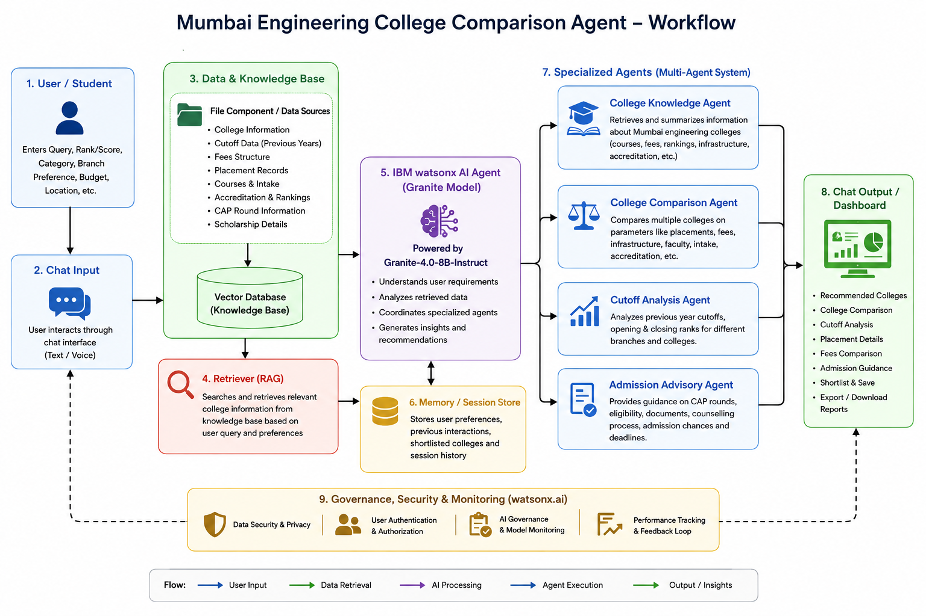

Slide 8
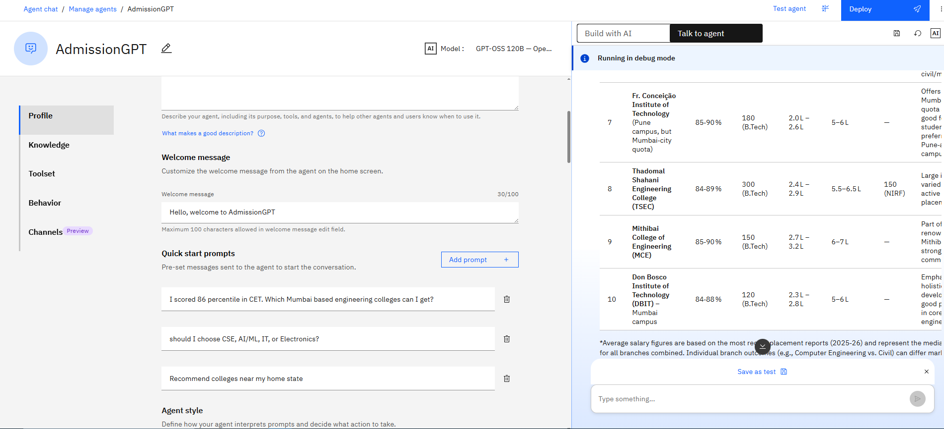
Screen Shot

Slide 9

Role of Agentic AI in the solution
Agentic AI enables the Mumbai Engineering College Comparison Agent to work as an intelligent decision-support system rather than a basic search tool. Using IBM watsonx.ai and IBM Granite models, it coordinates multiple specialized agents to collect college data, analyze student preferences, and provide personalized college recommendations.
Each agent performs a specific role—such as retrieving college information, comparing colleges, analyzing cutoffs, and suggesting suitable options—while working together to generate accurate results. This multi-agent approach helps students efficiently evaluate colleges based on rank, category, branch preference, fees, placements, and location.
Agentic AI provides context awareness by understanding student requirements and adapting recommendations according to their academic profile and career goals. It enables real-time analysis of college data and improves decision-making through continuous interaction between agents.
Overall, Agentic AI transforms the system into a smart college admission assistant that provides personalized comparisons, reliable insights, and simplified guidance for students selecting engineering colleges.

Slide 10
Git Hub Link
https://github.com/farhanasiddiqui-cmd/AdmissionGPT.git
·
·
·

Slide 11
Future Scope
Scope of the Agent – The Mumbai Engineering College Comparison Agent is currently focused only on engineering colleges in Mumbai, providing students with detailed comparisons and recommendations based on available admission, academic, and placement data. In the future, the system can be expanded to cover engineering colleges across India.
Integration with Admission Portals & Real-Time College Data – The system can be integrated with official admission portals and college databases to collect real-time information such as cutoff updates, seat availability, fees, course details, and admission notifications. This will enable the College Comparison Agent to provide accurate and updated recommendations based on current admission trends.
AI-Powered Voice Assistant & Multilingual Support – Enhancing the system with a voice-enabled assistant and multilingual support will improve accessibility for students. Users can interact naturally in their preferred language, making the platform easier to use and helping students from different backgrounds make better college selection decisions.
·
·
·

Slide 12


